Slide 1
Objectives
Evaluate the performance of gas power cycles for which the working fluid remains a gas throughout the entire cycle.
Develop simplifying assumptions applicable to gas power cycles.
Review the operation of reciprocating engines.
Analyze both closed and open gas power cycles.
Solve problems based on the Otto, Diesel, Stirling, and Ericsson cycles.
Solve problems based on the Brayton cycle; the Brayton cycle with regeneration; and the Brayton cycle with intercooling, reheating, and regeneration.
Analyze jet-propulsion cycles.
Identify simplifying assumptions for second-law analysis of gas power cycles.
Perform second-law analysis of gas power cycles.

Slide 2
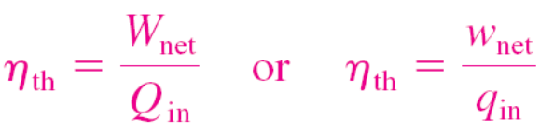
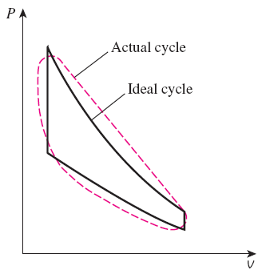
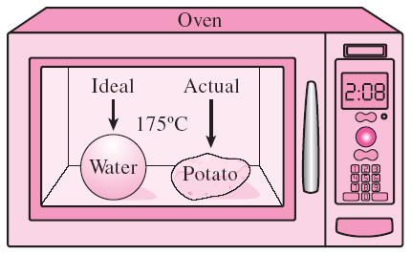
BASIC CONSIDERATIONS IN THE ANALYSIS OF POWER CYCLES
Thermal efficiency of heat engines:
Most power-producing devices operate on cycles.
Ideal cycle: A cycle that resembles the actual cycle closely but is made up totally of internally reversible processes.
Reversible cycles such as Carnot cycle have the highest thermal efficiency of all heat engines operating between the same temperature levels. Unlike ideal cycles, they are totally reversible, and unsuitable as a realistic model.
Modeling is a powerful engineering tool that provides great insight and simplicity at the expense of some loss in accuracy.
The analysis of many complex processes can be reduced to a manageable level by utilizing some idealizations.

Slide 3
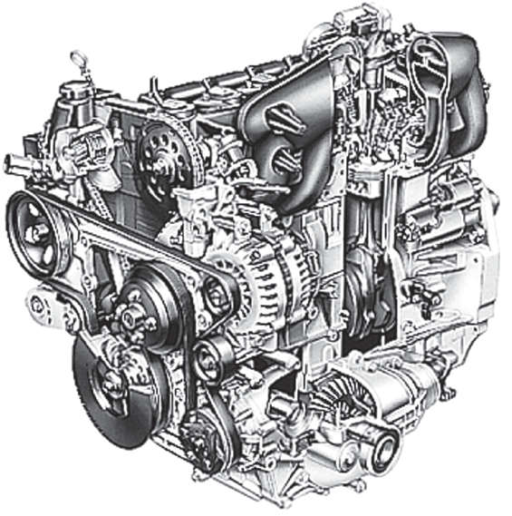
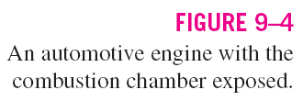
The ideal cycles are internally reversible, but, unlike the Carnot cycle, they are not necessarily externally reversible. Therefore, the thermal efficiency of an ideal cycle, in general, is less than that of a totally reversible cycle operating between the same temperature limits. However, it is still considerably higher than the thermal efficiency of an actual cycle because of the idealizations utilized.

Slide 4

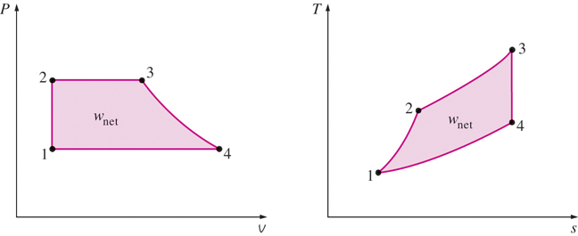
On a T-s diagram, the ratio of the area enclosed by the cyclic curve to the area under the heat-addition process curve represents the thermal efficiency of the cycle. Any modification that increases the ratio of these two areas will also increase the thermal efficiency of the cycle.
The idealizations and simplifications in the analysis of power cycles:
The cycle does not involve any friction. Therefore, the working fluid does not experience any pressure drop as it flows in pipes or devices such as heat exchangers.
All expansion and compression processes take place in a quasi-equilibrium manner.
The pipes connecting the various components of a system are well insulated, and heat transfer through them is negligible.
Care should be exercised in the interpretation of the results from ideal cycles.
On both P-v and T-s diagrams, the area enclosed by the process curve represents the net work of the cycle.

Slide 5
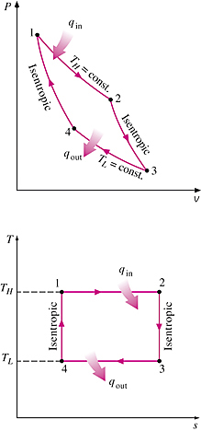

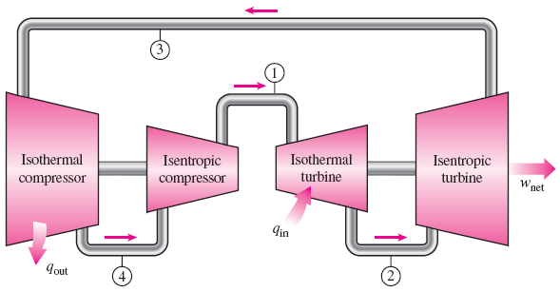
THE CARNOT CYCLE AND ITS VALUE IN ENGINEERING
The Carnot cycle is composed of four totally reversible processes: isothermal heat addition, isentropic expansion, isothermal heat rejection, and isentropic compression.
For both ideal and actual cycles: Thermal efficiency increases with an increase in the average temperature at which heat is supplied to the system or with a decrease in the average temperature at which heat is rejected from the system.
P-v and T-s diagrams of a Carnot cycle.
A steady-flow Carnot engine.

Slide 6
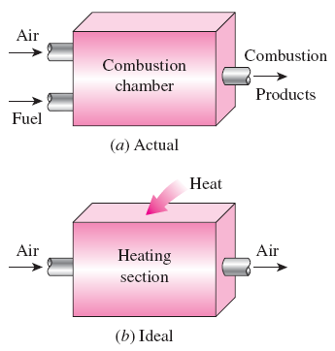
AIR-STANDARD ASSUMPTIONS
Air-standard assumptions:
The working fluid is air, which continuously circulates in a closed loop and always behaves as an ideal gas.
All the processes that make up the cycle are internally reversible.
The combustion process is replaced by a heat-addition process from an external source.
The exhaust process is replaced by a heat-rejection process that restores the working fluid to its initial state.
The combustion process is replaced by a heat-addition process in ideal cycles.
Cold-air-standard assumptions: When the working fluid is considered to be air with constant specific heats at room temperature (25°C).
Air-standard cycle: A cycle for which the air-standard assumptions are applicable.

Slide 7
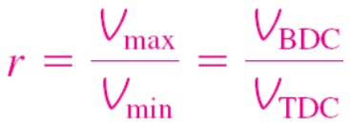
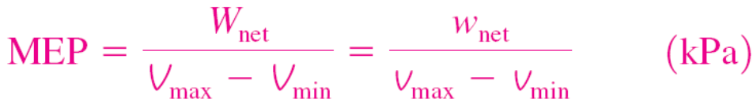
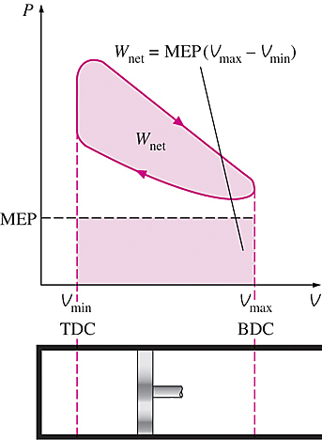
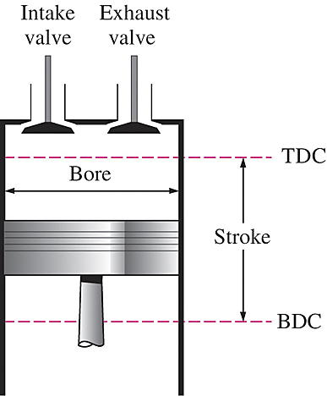
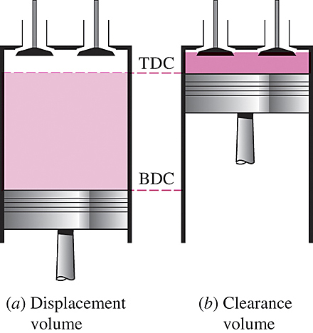
AN OVERVIEW OF RECIPROCATING ENGINES
Compression ratio
Mean effective pressure
Spark-ignition (SI) engines
Compression-ignition (CI) engines
Nomenclature for reciprocating engines.

Slide 8
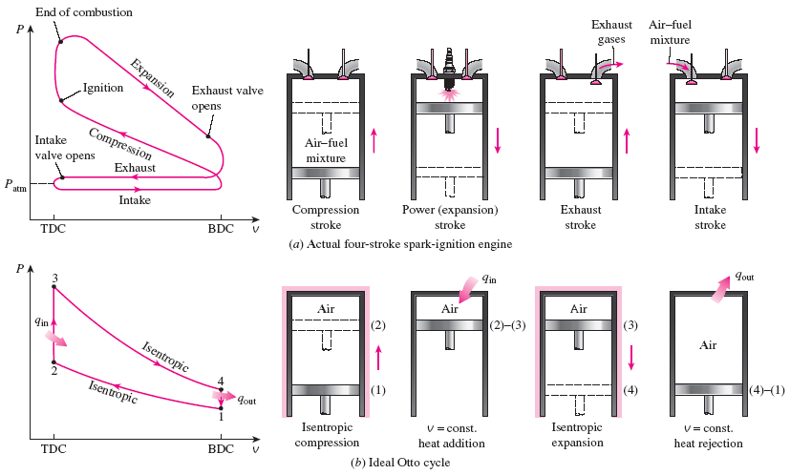
OTTO CYCLE: THE IDEAL CYCLE FOR SPARK-IGNITION ENGINES
Actual and ideal cycles in spark-ignition engines and their P-v diagrams.

Slide 9
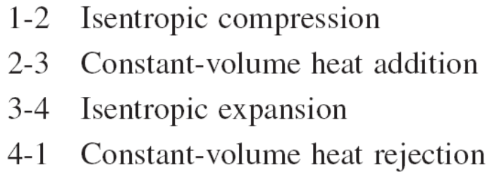
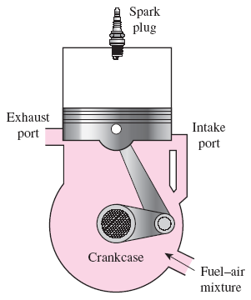
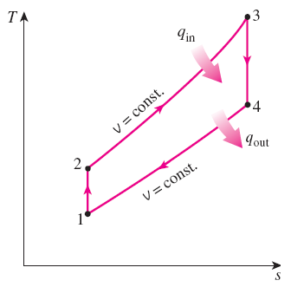
The two-stroke engines are generally less efficient than their four-stroke counterparts but they are relatively simple and inexpensive, and they have high power-to-weight and power-to-volume ratios.
Four-stroke cycle
1 cycle = 4 stroke = 2 revolution
Two-stroke cycle
1 cycle = 2 stroke = 1 revolution
T-s diagram of the ideal Otto cycle.
Schematic of a two-stroke reciprocating engine.

Slide 10
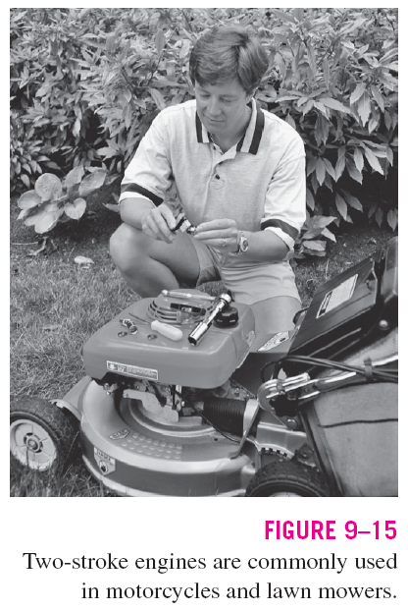

Slide 11
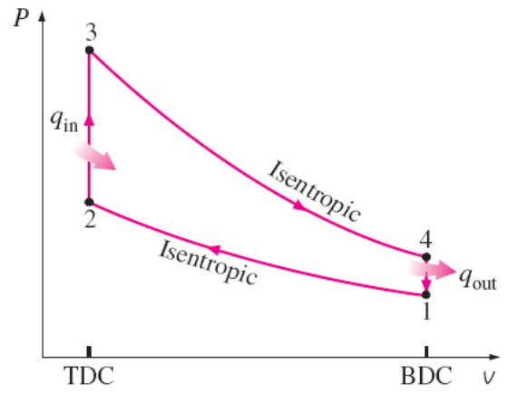
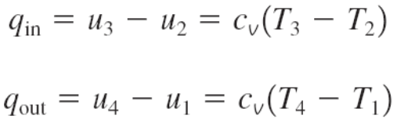


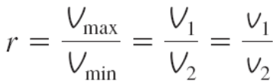
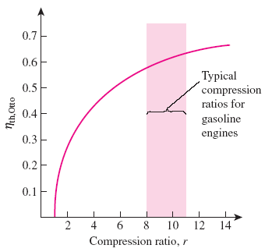
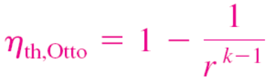
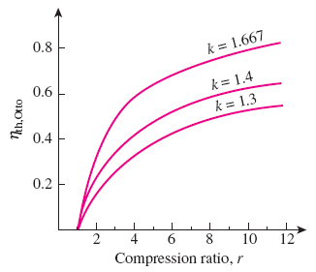
In SI engines, the compression ratio is limited by autoignition or engine knock.
The thermal efficiency of the Otto cycle increases with the specific heat ratio k of the working fluid.
Thermal efficiency of the ideal Otto cycle as a function of compression ratio (k = 1.4).

Slide 12
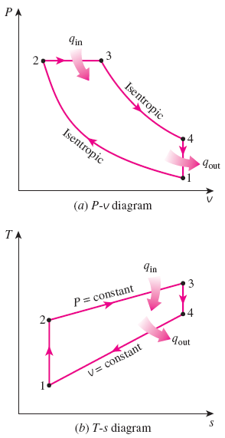
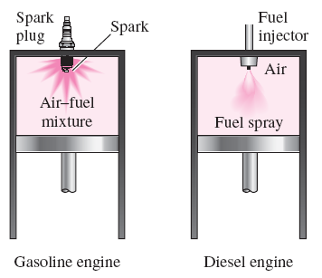
DIESEL CYCLE: THE IDEAL CYCLE
FOR COMPRESSION-IGNITION ENGINES
In diesel engines, only air is compressed during the compression stroke, eliminating the possibility of autoignition (engine knock). Therefore, diesel engines can be designed to operate at much higher compression ratios than SI engines, typically between 12 and 24.
1-2 isentropic compression
2-3 constant-volume heat addition
3-4 isentropic expansion
4-1 constant-volume heat rejection.
In diesel engines, the spark plug is replaced by a fuel injector, and only air is compressed during the compression process.

Slide 13
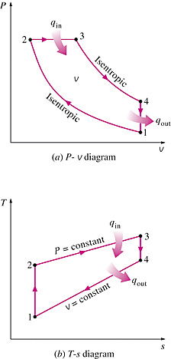
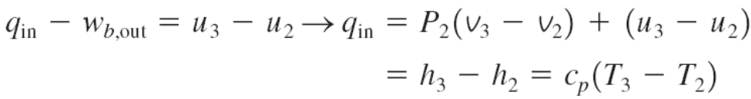
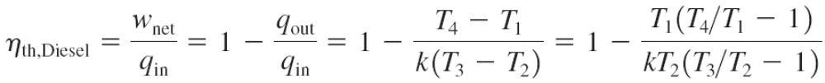
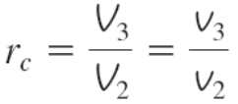
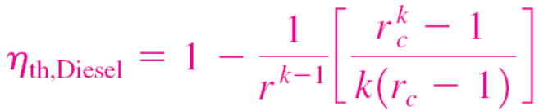

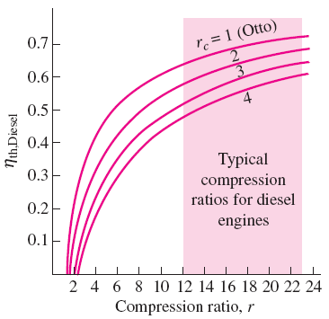
Cutoff ratio
for the same compression ratio
Thermal efficiency of the ideal Diesel cycle as a function of compression and cutoff ratios (k=1.4).

Slide 14
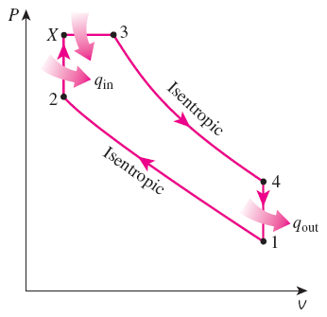
Dual cycle: A more realistic ideal cycle model for modern, high-speed compression ignition engine.
QUESTIONS ???
Diesel engines operate at higher air-fuel ratios than gasoline engines. Why?
Despite higher power to weight ratios, two-stroke engines are not used in automobiles. Why?
The stationary diesel engines are among the most efficient power producing devices (about 50%). Why?
What is a turbocharger? Why are they mostly used in diesel engines compared to gasoline engines.
P-v diagram of an ideal dual cycle.

Slide 15
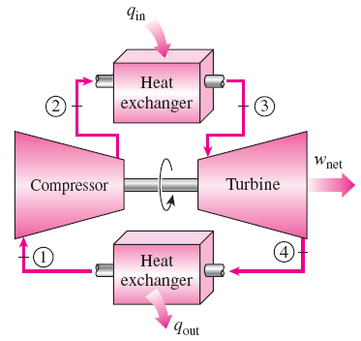
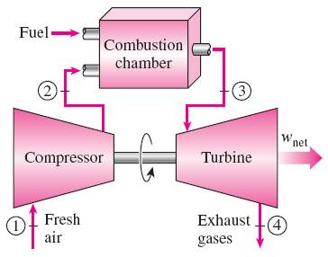
BRAYTON CYCLE: THE IDEAL CYCLE FOR GAS-TURBINE ENGINES
The combustion process is replaced by a constant-pressure heat-addition process from an external source, and the exhaust process is replaced by a constant-pressure heat-rejection process to the ambient air.
1-2 Isentropic compression (in a compressor)
2-3 Constant-pressure heat addition
3-4 Isentropic expansion (in a turbine)
4-1 Constant-pressure heat rejection
An open-cycle gas-turbine engine.
A closed-cycle gas-turbine engine.

Slide 16
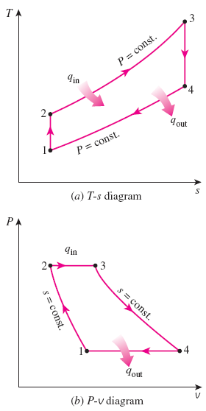


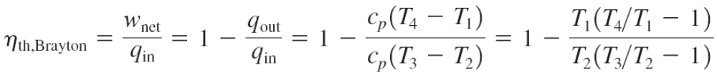
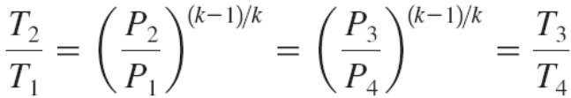
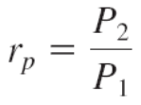
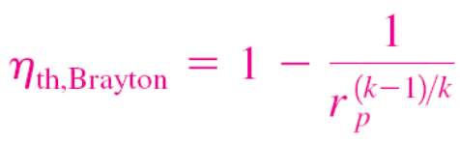
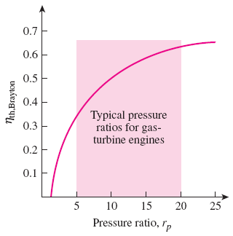
Pressure ratio
Thermal efficiency of the ideal Brayton cycle as a function of the pressure ratio.
T-s and P-v diagrams for the ideal Brayton cycle.

Slide 17
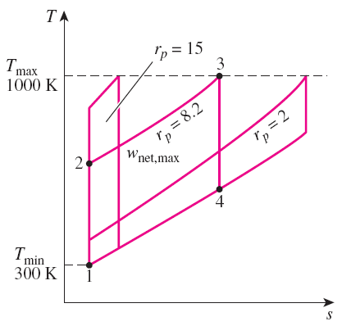
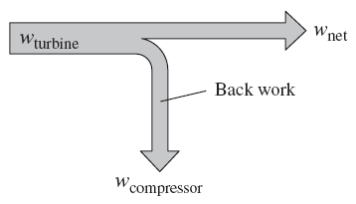
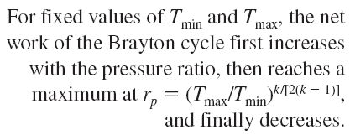
The two major application areas of gas-turbine engines are aircraft propulsion and electric power generation.
The highest temperature in the cycle is limited by the maximum temperature that the turbine blades can withstand. This also limits the pressure ratios that can be used in the cycle.
The air in gas turbines supplies the necessary oxidant for the combustion of the fuel, and it serves as a coolant to keep the temperature of various components within safe limits. An air–fuel ratio of 50 or above is not uncommon.
The fraction of the turbine work used to drive the compressor is called the back work ratio.

Slide 18
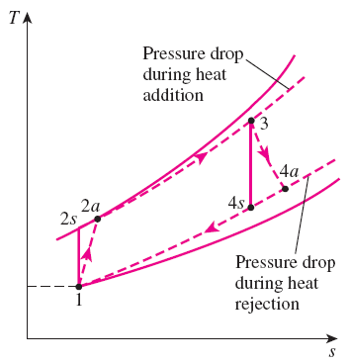
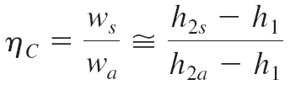
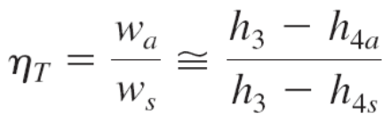
Development of Gas Turbines
Increasing the turbine inlet (or firing) temperatures
Increasing the efficiencies of turbomachinery components (turbines, compressors):
Adding modifications to the basic cycle (intercooling, regeneration or recuperation, and reheating).
Deviation of Actual Gas-Turbine Cycles from Idealized Ones
Reasons: Irreversibilities in turbine and compressors, pressure drops, heat losses
Isentropic efficiencies of the compressor and turbine
The deviation of an actual gas-turbine cycle from the ideal Brayton cycle as a result of irreversibilities.

Slide 19
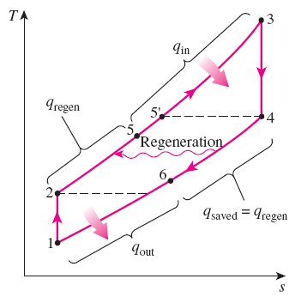
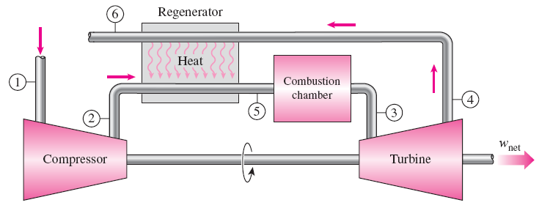
THE BRAYTON CYCLE WITH REGENERATION
In gas-turbine engines, the temperature of the exhaust gas leaving the turbine is often considerably higher than the temperature of the air leaving the compressor.
Therefore, the high-pressure air leaving the compressor can be heated by the hot exhaust gases in a counter-flow heat exchanger (a regenerator or a recuperator).
The thermal efficiency of the Brayton cycle increases as a result of regeneration since less fuel is used for the same work output.
T-s diagram of a Brayton cycle with regeneration.
A gas-turbine engine with regenerator.

Slide 20






Effectiveness of regenerator
Effectiveness under cold-air standard assumptions
Under cold-air standard assumptions
T-s diagram of a Brayton cycle with regeneration.
Can regeneration be used at high pressure ratios?
The thermal efficiency depends on the ratio of the minimum to maximum temperatures as well as the pressure ratio.
Regeneration is most effective at lower pressure ratios and low minimum-to-maximum temperature ratios.
Thermal efficiency of the ideal Brayton cycle with and without regeneration.

Slide 21



THE BRAYTON CYCLE WITH INTERCOOLING, REHEATING, AND REGENERATION
For minimizing work input to compressor and maximizing work output from turbine:
A gas-turbine engine with two-stage compression with intercooling, two-stage expansion with reheating, and regeneration and its T-s diagram.

Slide 22


Multistage compression with intercooling: The work required to compress a gas between two specified pressures can be decreased by carrying out the compression process in stages and cooling the gas in between. This keeps the specific volume as low as possible.
Multistage expansion with reheating keeps the specific volume of the working fluid as high as possible during an expansion process, thus maximizing work output.
Intercooling and reheating always decreases the thermal efficiency unless they are accompanied by regeneration. Why?
Comparison of work inputs to a single-stage compressor (1AC) and a two-stage compressor with intercooling (1ABD).
As the number of compression and expansion stages increases, the gas-turbine cycle with intercooling, reheating, and regeneration approaches the Ericsson cycle.

